Slide 2
Supply Chain Disruptions
Product Availability
Lead Time Increases
Price Increases
Quality Standards
Cash Constraints
Forecast Demand

Slide 3
Order Fulfillment Strategies
CUSTOMERS
Finished Goods
(SKUs)
MPS
WIP (LT)
MPS
MPS
Design
Raw Material
(SKUs)
MPS
MTS
MTO
ATO/CTO
ETO
SUPPLIERS

Slide 4
How to Respond
Economics
MISys
Supplier Relations
Lead Time Accuracy
Price Accuracy
Qualified Suppliers
Update LT
Update Price

Slide 5
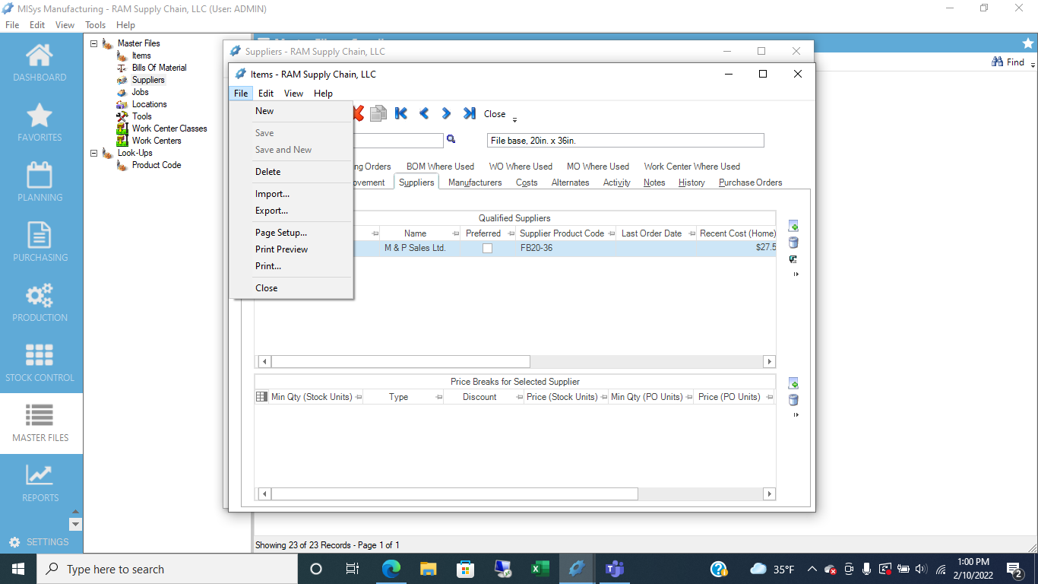

Slide 6
How to Respond
Economics
MISys
Standard Costs
Unfavorable PPV
Price Variance
Cost of Goods Sold
Update Standards
Items with Large Increase
Update Price/Standards
Inventory Valuation

Slide 8
How to Respond
Economics
MISys
Product Availability
Inventory Accuracy
Perform PI
Physical Inventory
Inventory Valuation

Slide 9
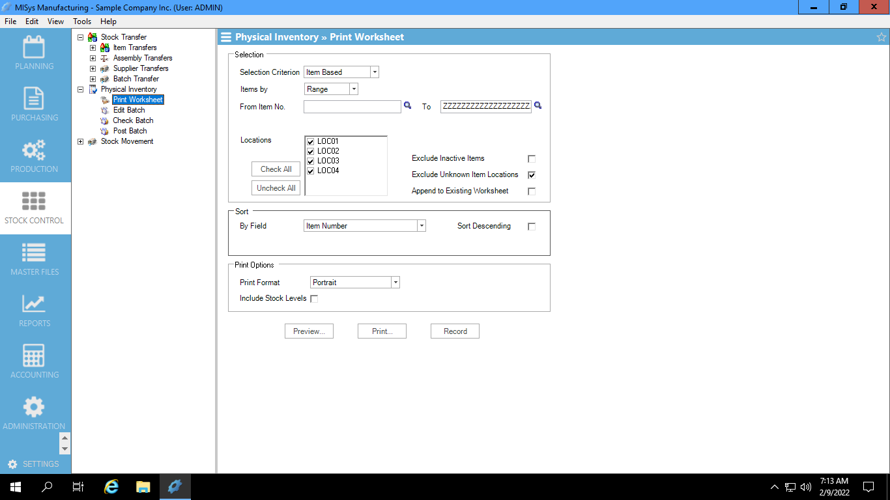

Slide 10
How to Respond
Economics
MISys
Forecast Demand
Pipeline Mgmt
MPS
Process Batch
Demand Forecast

Slide 11
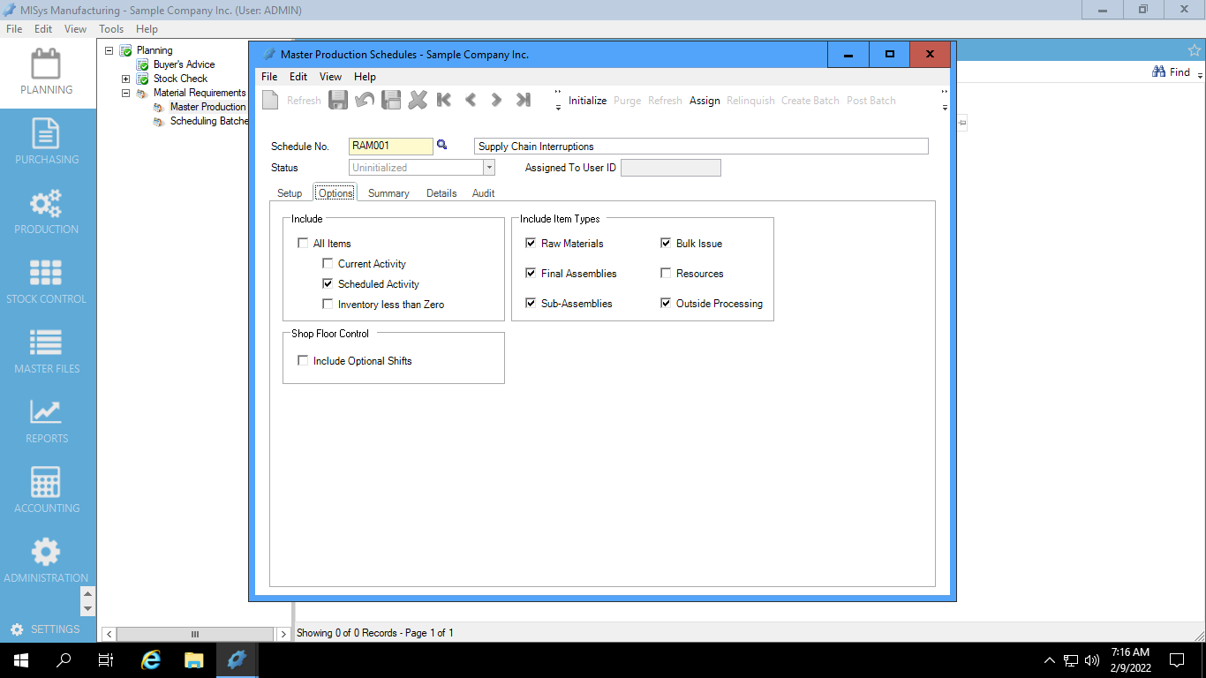

Slide 12
Questions?
How do we deal with Chip shortages in the electronic industry?
Doug Boehm – Senix Corporation
Answer: Supplier Relationship Management (SRM)
Develop long-term partnership with key suppliers by sharing MRP in time-phased horizons
Firm Commit
Material Commit
Forecast (Information Only)
Delivery Schedules (Weekly/Daily)

Slide 13
MISys Support: misysinc.com/helpdesk
MISys Live Ask & Answer: misysinc.com/UGM
CONTACT
RAM Supply Chain
Rich Mihelich, Managing Partner Phone (440) 248-0018 rmihelich@ramscm.com
ramscm.com

